Slide 1
Smart Car Parking System
using
Arduino uno & infrared obstacle sensor

Slide 2
What is Smart Car parking System?
Basically Smart car parking system lets the drives know if any parking slot is vacant in the complex where he/ she can park the vehicle.
Here basic electronic devices are being used like Arduino UNO, IR obstacle sensor etc.

Slide 3
Core Components regrading the project :
Arduino Uno
IR obstacle sensor
Servo Motor
Bread Board

Slide 4
Work plan to Conduct the project
Design the Circuit Diagram
To connect the obstacle sensors and LEDs.
Prepare a circuit for the whole parking arena.
Finally connect the Arduino with the circuit using bread board and upload the code to IDE.
Design
Connect
Implement

Slide 5
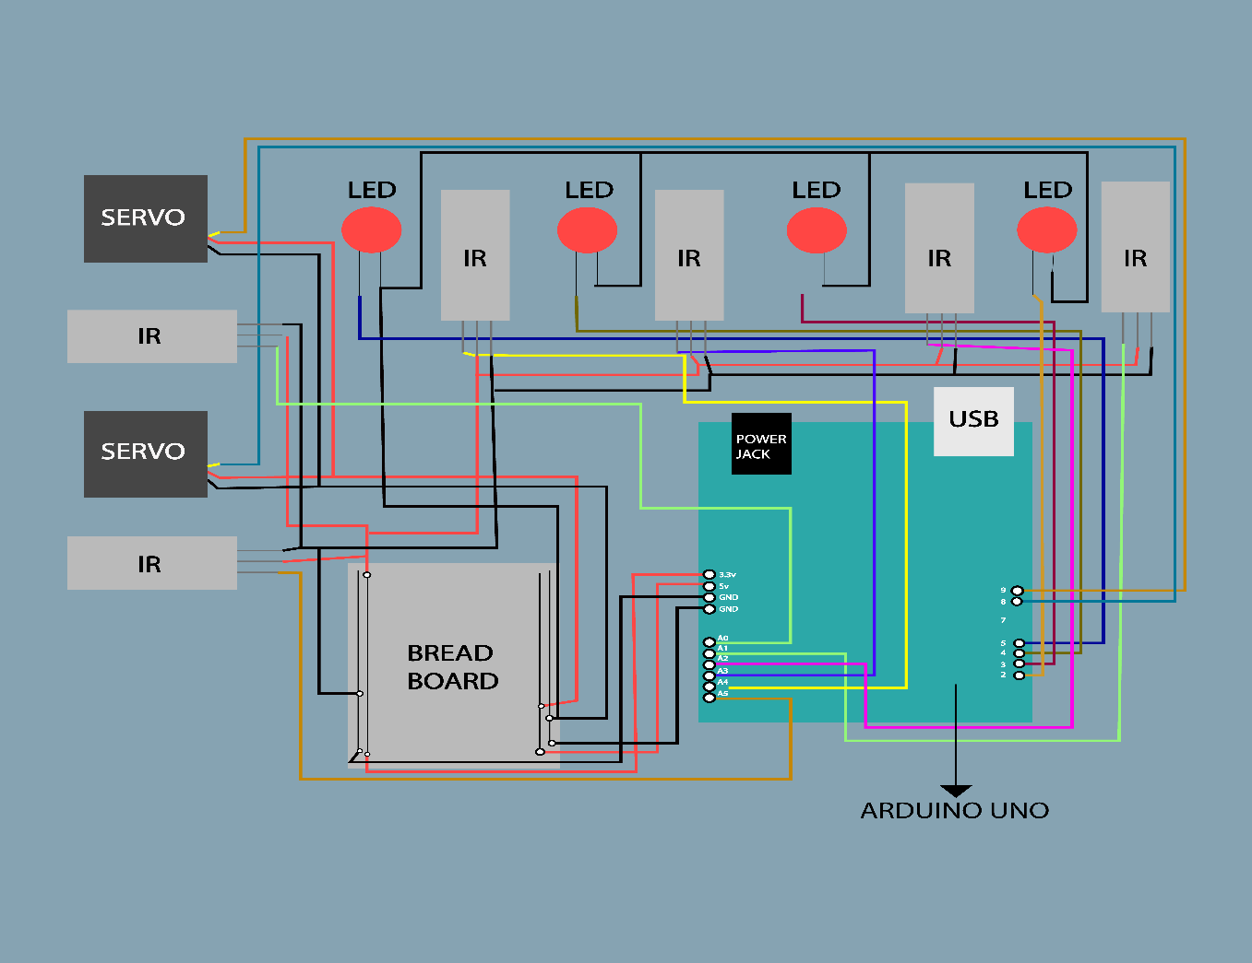
Circuit Diagram :

Slide 6
Importance and Applicability of Smart Car Parking System
Importance:
Automated
Time saving
Increase in Safety of the vehicle
Takes away the unpredictability of finding a parking spot
Save money
More Productive and Efficient

Slide 7
Applicability :
Parking spot of any industrial area
Shopping mall or Public places
Apartment Complex
Mass Parking Complex
Residential Areas

